Slide 1
This is the Place for the Title
Rank, Name
Office Symbol
Date of Briefing

Slide 2
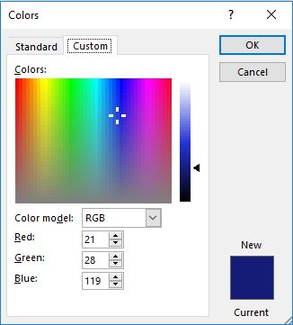
Title Slide Details
All slides will be in widescreen format (use this template to start new slide builds)
The title slide (see previous slide) should be in Arial, bold, 44 point and the standard blue
  The AF standard blue is: Hue 167, Sat 179, Lum 70, Red 21, Green 28, and Blue 119
Aligned with the top of the AF symbol star should be
  Rank, Name of briefer
  Office symbol should be on the line below
  Date the briefing is given
  All will be black, bold, 20 point Arial, and right justified

Slide 3

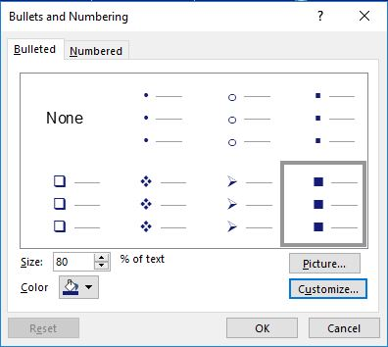
Right Justified Title 36 Point
The guides (vertical and horizontal alignment) are set at 6.17 and 2.17
  When inserting a new text box, ensure the text box is aligned with these set guides
Line spacing is always single spaced
The spacing above all major bullets, like this one, is 12 pt
  The spacing above this all sub-bullets is 6 pt
    You set this under “Paragraph” on the toolbar
All type will be in Arial, black, bold, and 20 point
  Bullets are Wingdings font squares, 80% size and standard blue

Slide 4
Other Details
Slides should always be in narrative format and self-explanatory
Bullets and sub-bullets should not end in periods
An orphan is a single word on its own line
  This sub-bullet is added here for the purpose of demonstrating what is meant by an orphan
  Ensure slides do not have orphans
Limit abbreviations
Standardize dates (e.g. 11 Jul 19)
Page numbers should be displayed on all slides, after the Title slide, in the lower right-hand corner
Utilize this box for the slide’s main take-away

Slide 5
Even More Details
If “perishable” data is included on slides, there should be a small text box inserted at the bottom to annotate the source of the data and its current as of date (10 font, Arial, non-bold, align with bullets) – see box below
“Perishable” data is data that may change over time and not be valid later
Use of this box is at the discretion of the brief’s producer; the intent of this box is to convey that the data may change over time, which may drive a different decision
Data provided by ________ and is current as of ___________

Slide 6

The Air Force’s Personnel Center

Slide 7

Meeting Purpose
A1 Priority Areas
Purpose of Meeting
Responsive
Agile
Information / Status / Decision
Empowering Performance
Transparent and Simple
Milestones/Deadlines/Desired Outcomes
Way Ahead/Recommendations
Key Milestones
Way Ahead
Notes:
This is a content template for read-ahead slides (BLUF slide). This slide should identify which A1 priority area the meeting/briefing relates to, as well as clearly define the meeting/briefing purpose and desired outcome. Include this slide with all slide decks.

